Slide 1
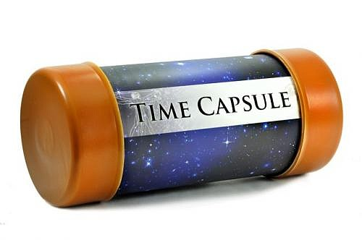
Time capsule
We are currently living our lives like we never have before, and hopefully never will again. In the future, children in schools will be learning about social distancing, lockdown and the coronavirus in their history classes.

Slide 2
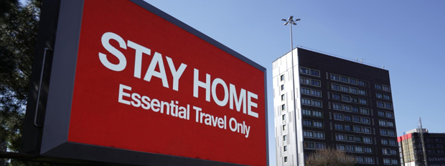
Time capsule
To help the students of the future you could create a time capsule which describes your time in lockdown.

Slide 3
What is a time capsule?
Time capsules are containers of some kind which hold a selection of objects, picked because they have a special meaning in the time that we’re living in.
For example, time capsules have been found from as early as 1874 in the UK with photographs and letters, describing daily events happening that year.
Often time capsules are buried underground, beneath floorboards or stone slabs. For example, in 2015 one was buried under the Millennium Dome in London to be opened in 2050.
With the coronavirus pandemic, we are all living through an important moment in history. Many people want to help future generations learn about this time using time capsules, full of things that show what life under lockdown was like.

Slide 4
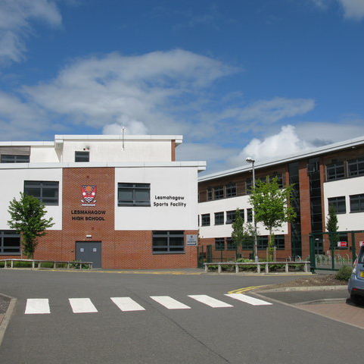
What will we do with them?
Physical Time Capsules
If you have created a physical time capsule with objects and pictures in it, we would love to bury them in the school grounds when we return. It would be lovely to mark the occasion with an official “Time Capsule Ceremony”!
Digital Time Capsules
If you have created a digital time capsule, you can email us your work so we can collate them all and save it for the future.

Slide 5

Social Subject Skill Development
Why not include some subject specific information? This will help you develop your skills but will also help students studying those subjects in the future. Included in the next few slides are some activities from each subject.

Slide 6
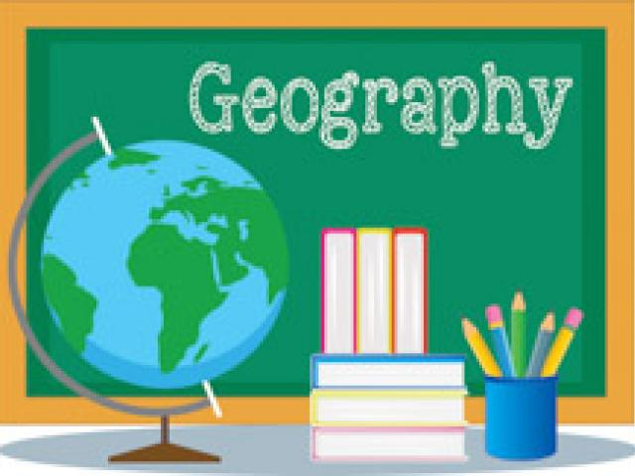
Geography
In Geography we study the world, its landscapes, places, people and their relationship with the environment.
Geography seeks to make sense of the world we live in.
One of the first things you learn is the 3 types of Geography:
1 – Physical Geography
2- Human Geography
3- Environmental Geography

Slide 7

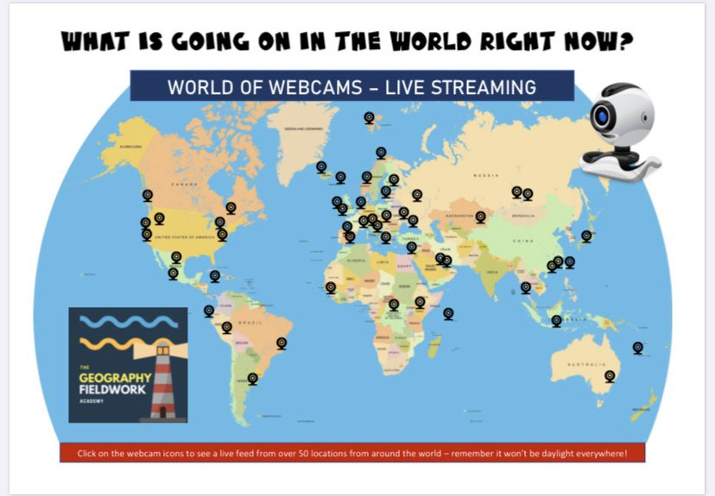
Geography Task 1: What’s going on in the world right now?
Our lives are very different just now as we follow government guidelines during Lockdown. Scenes from all over the world highlight how different life is. Those busy streets, beaches, restaurants are all now quiet. People leave home for essentials and for exercise.
Lets have a look at what is going on in the world right now…
Task 1: What’s going on in the world right now?
It would be very interesting for future pupils to see how different the world looks at this time.
Click on the link to see live webcams from around the world.. For each location…
1 . Have a look at the live webcam.
2. Compare this scene to the “normal” view of this area .
3. Write a short paragraph to describe the differences. (in what ways are humans interacting with their environment in a different way? Can you think of any positives of this, particularly for the environment?)

Slide 8
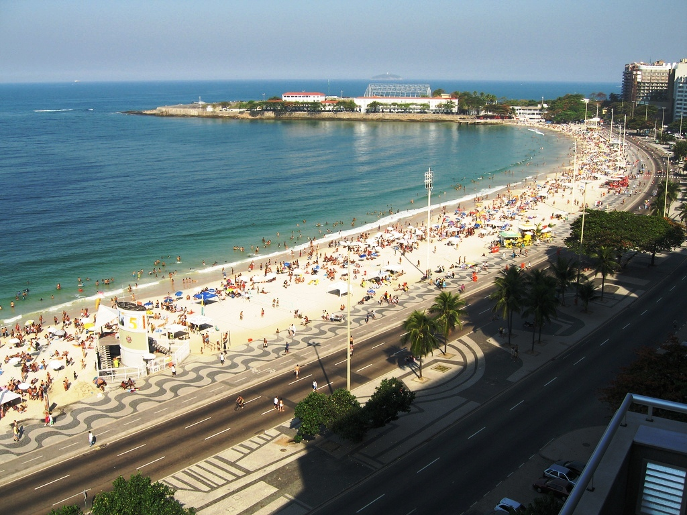
Location 1: Copacabana Beach
“normal view” of Copacabana Beach (Rio, Brazil)

Slide 9
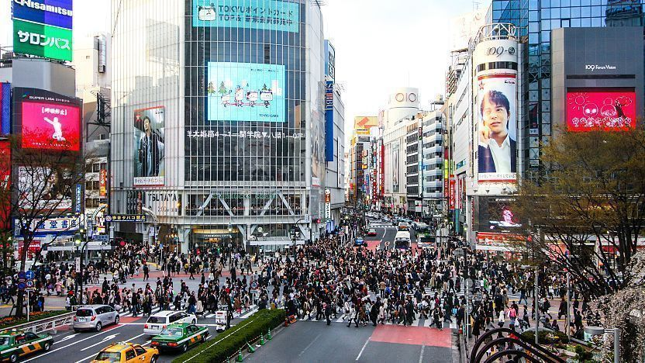
Location 2: Shibuya Crossing
“normal view” of Shibuya Crossing (Tokyo, Japan)

Slide 10
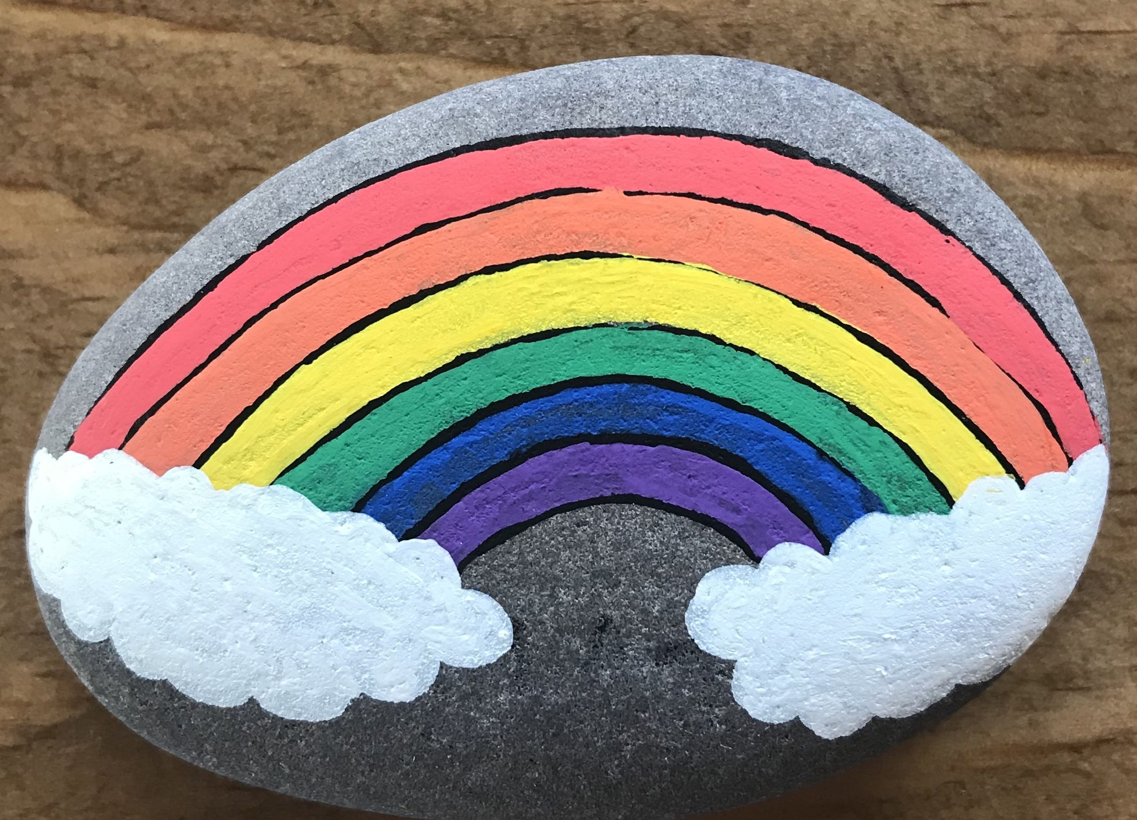
Geography Task 2: What’s going on in the local area?
Now let’s have a look at how different our environment around us looks, when we leave the house for essentials or daily exercise.
Task 2: What’s going on in the local area?
Can you think of a place that you have been to during lockdown, that looks very different now?
(This could be a place you go for a walk in the countryside that is now busier with walkers and runners, or a supermarket with one-way systems, or houses with rainbows in windows)
Next time you go there try to …
Take photographs to show future pupils how the local area looks very different
Collect rocks from your walk to paint (e.g. rainbows, thank the NHS)
….we can bury these in our time capsule!

Slide 11
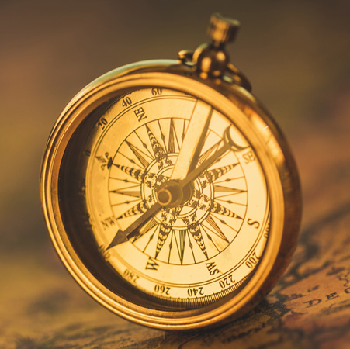
History
In History we learn about people, events and society from the past, from ancients through to the 20th century. By examining the past we can understand our own community, country and the wider world a little better.

Slide 12

History Task 1: People
During lockdown, try to gather together pieces of evidence which will allow people in the future to understand what lockdown was like for families in Scotland.
Possible sources of evidence could include:
Written evidence- diaries, newspapers, articles, letters and receipts
Visual evidence- pictures and photographs
Oral evidence- interviews with family
Artefacts (objects)- face masks, hand gel

Slide 13
History task 2: Past events
One way of making sense of history is to make a timeline of key events. Try doing this for lockdown. A possible start is outlined below:
December 2019 Covid-19 confirmed in Wuhan, China
January 2020 First case of Covid-19 confirmed in the UK
March 2020 First case of Covid-19 confirmed in Scotland
March 2020 Prime Minister Boris Johnston announces UK wide lockdown
April 2020 …

Slide 14
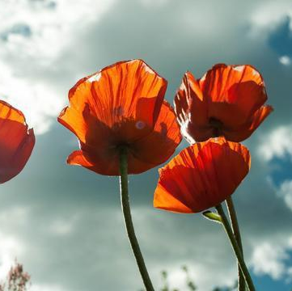
History Task 3: Society
Important events in history are often remembered and commemorated in the years which follow. We remember those who died in war every November, and this month we remember specifically the end of WWII in Europe 75 years ago. Think about how we should remember the events of 2020.
Do you think there will be a day of remembrance?
Should we create memorials for those who died?
Is there something we could wear, as we do with poppies?
How do you think we should remember 2020?

Slide 15
Modern Studies
In Modern Studies we learn about what is happening in the world right now. In history you learn about events that have happened in the past. In Modern Studies you learn about Modern Day events. The topics that you study can be split into three sections:
1. Political Issues- These effect the way that a country Is run.
2. Economic Issues- These effect how much money a country has.
3. Social Issues- These effect the quality and type of life that people have.

Slide 16
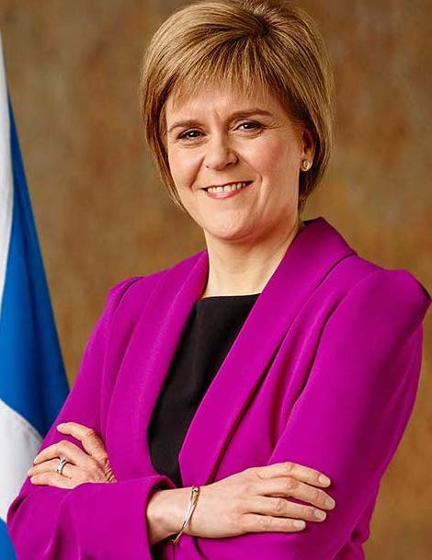
Modern Studies Task 1: Political Issues
Every country in the world has a political leader. Some have a Prime Minster, others a President. In Scotland we have a First Minister, her name is Nicola Sturgeon. When the Coronavirus infected countries it was the political leaders choice how to respond.
Task 1: Scotland’s Political Response to the Virus
It would be very interesting for future pupils to know how Nicola Sturgeon responded to the Coronavirus. You could create a diary entry about Scotland’s political response to the virus by including answers to the questions below. (You can use the internet to research the questions)
1. Why did Nicola Sturgeon decide to close Scottish Schools?
2. On what date did she make this decision?
3. Some of you might have older brothers and sisters, do you know what happened to their exams this year?
4. Do you think that this was a good decision by Nicola Sturgeon to close the schools, can you explain why?
5. If you could ask Nicola Sturgeon one question, what would it be?

Slide 17
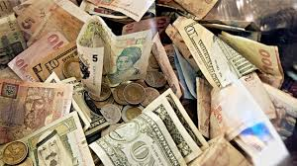
Modern Studies Task 2: Economic Issues
Economic issues are all about how much money different countries in the world have. They explain why some countries are very rich and why other countries are very poor. When the virus infected countries it has started to have a negative impact on many countries' economies.
Task 2: The Economic Impact of Coronavirus on Scotland
Imagine that you were a business owner. Perhaps of a coffee shop or a sweet shop.
In what way do you think that Coronavirus would impact how much money that your business was making and your employees?
Is there any ways that your business could continue to make money that is within the Coronavirus guidelines (e.g. Deliveries).

Slide 18
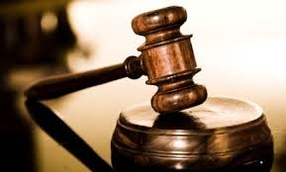
Modern Studies Task 3: Social Issues
Every person is impacted by their surroundings. This could be the area that they live (countryside or city), who they live with (parents, grandparents, carer’s etc), how much income their family have, the crime rates in their local area or even the people that they socialize with.
Task 2: The Social Impact of Coronavirus on Scotland
The Virus has changed the way that we live our lives on a daily basis. It would be very interesting for future pupils to find out about this.
Do you think that it would be best to live in a city or a countryside at this time, give reasons for your choice.
In what ways can you still continue to socialize with people without seeing them in person?
Do you think crime rates have increased or decreased, explain why? Have some types of crime become more common?

Slide 19

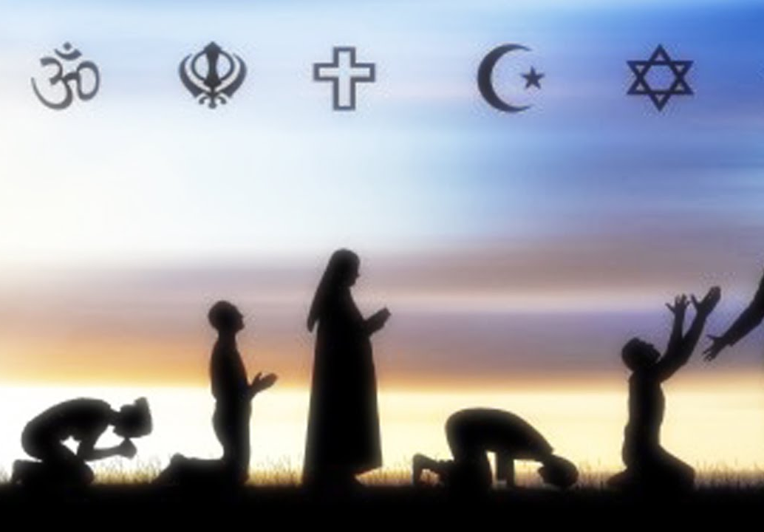
RMPS
Religious, Moral and Philosophical Studies

Slide 20
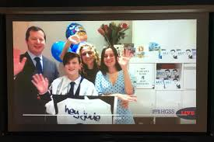
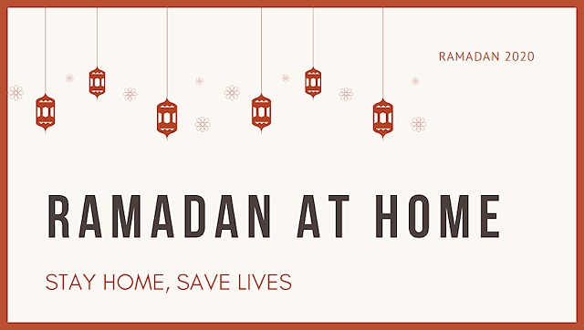
RMPS Task 1: Religion
Religious leaders around the world are faced with many new challenges. It would be very interesting in the future to look back at how they adapted.
Are religious services conducted in the same way? What changes have places like churches and mosques made to keep in touch with their communities?
How have religious festivals and events been different under lockdown?
What about rites of passage like funerals, weddings or Bar Mitzvahs?

Slide 21
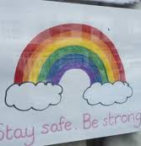
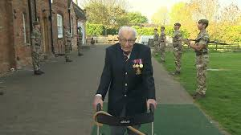
RMPS Task 2: Morality
In times of crisis, we often see people carrying out great acts of kindness or bravery. It would be wonderful to document some of these acts in your time capsule.
Investigate someone who has gone above and beyond to help their community, save lives or raise money.
What small things have people been doing to help others?

Slide 22
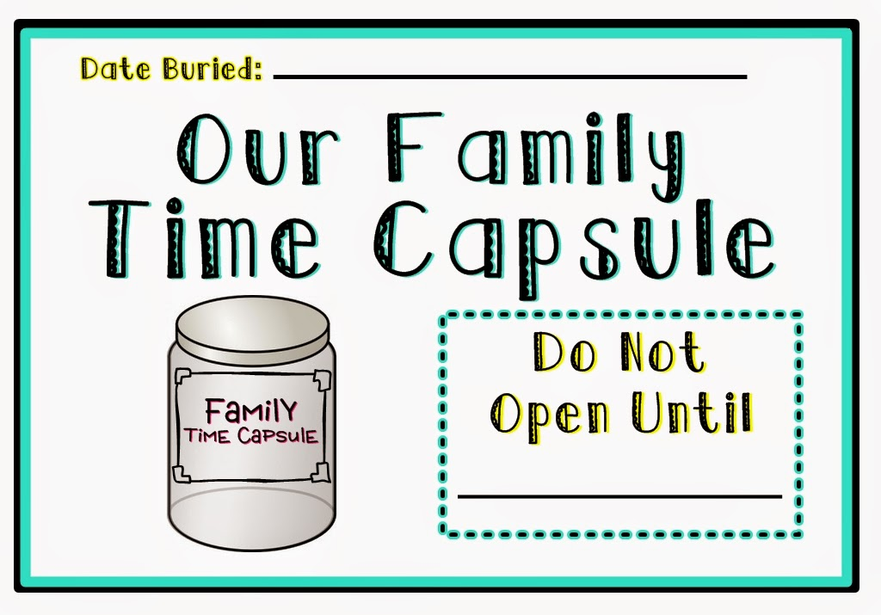
We look forward to seeing what you create!

